Slide 1
Introduction to Embedded Software Development

Slide 2
Development Suites
MDK-ARM
ARM-DS5
IAR Embedded Workbench for ARM Cortex-M
Red Suite
Mendor Graphics Sourcery CodeBench
ImageCraft
CrossWorks
TI CCS
GCC
Arduino

Slide 3
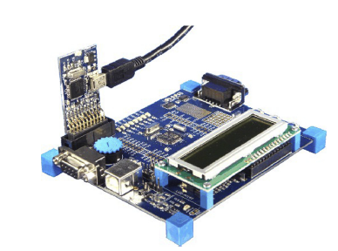
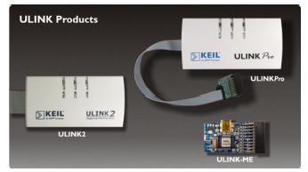
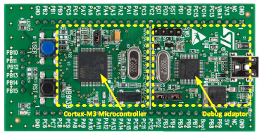
Development Boards

Slide 4
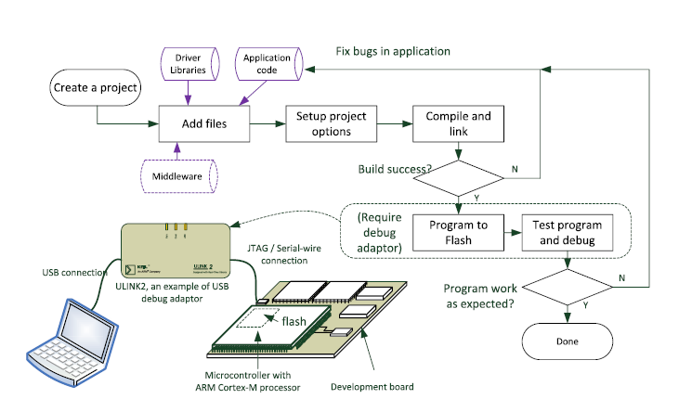
Software development flow
Compile and link
Flash programming
Execute program and debug

Slide 5
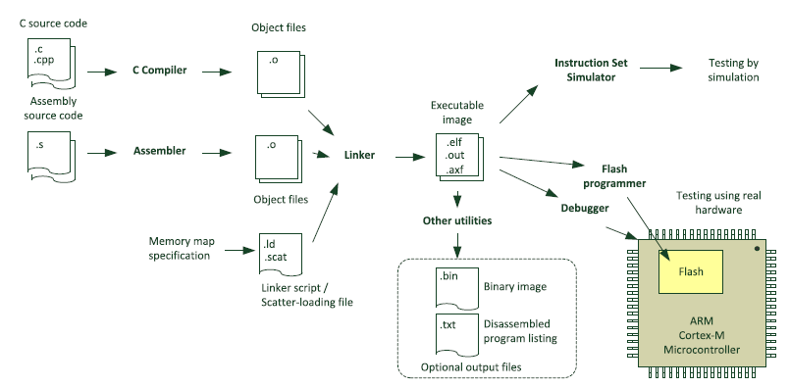
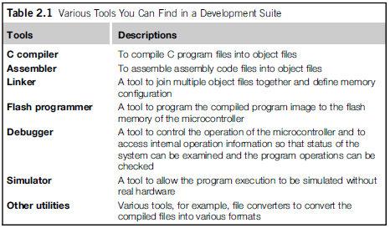
Compiling your application

Slide 6
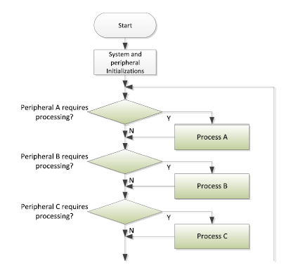
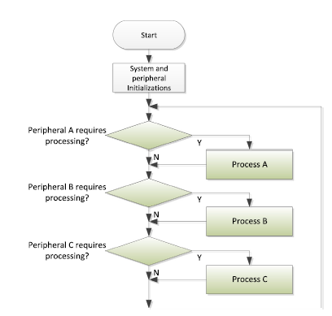
Software flow

Slide 7
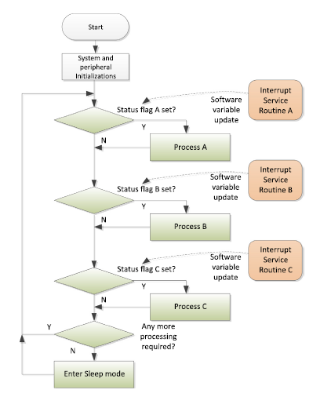
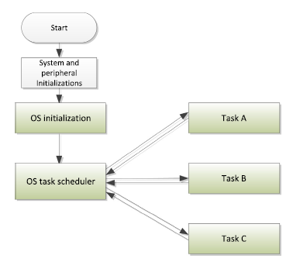
Multi-tasking System

Slide 8
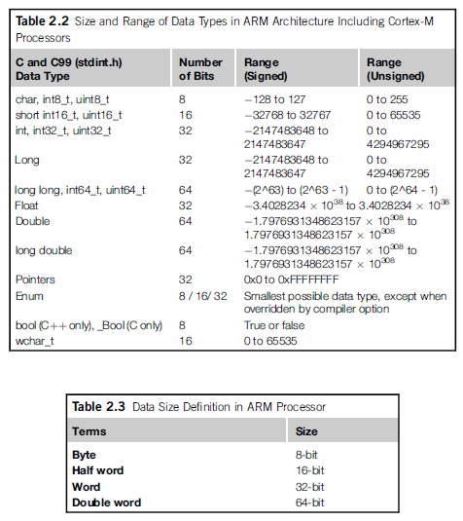
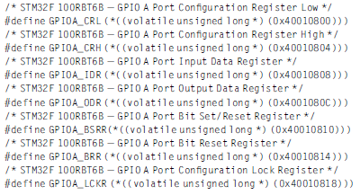
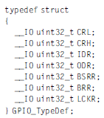
Data types and IO access

Slide 9
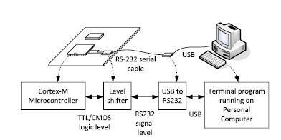
Microcontroller interface

Slide 10
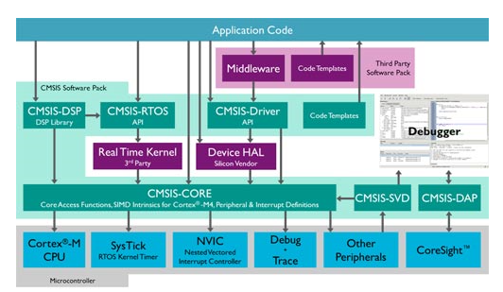
CMSIS(Cortex-M Software Interface Standard)
Aims of CMSIS
Embedded software reusability
Enhanced software compatibility
Easy to learn
Toolchain independent
Openness
https://www.arm.com/products/processors/cortex-m/cortex-microcontroller-software-interface-standard.php

Slide 11
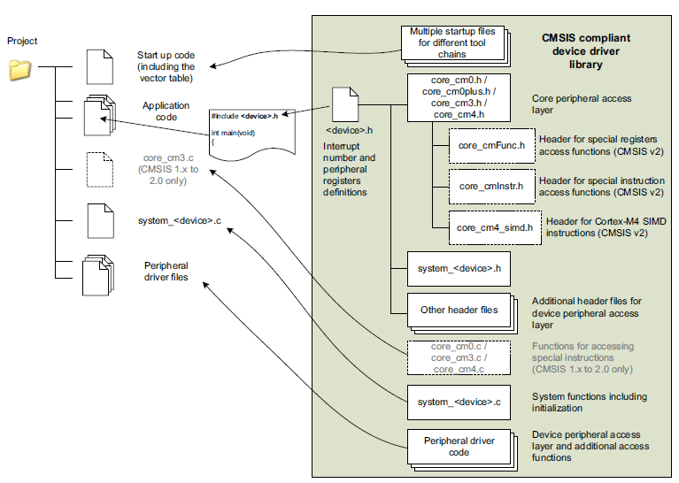
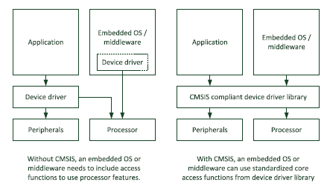
CMSIS Core structure
Embedded software portability and reusability
faster time to market
Compliant MISRA

Slide 12
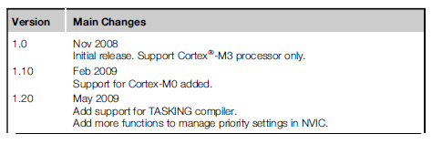
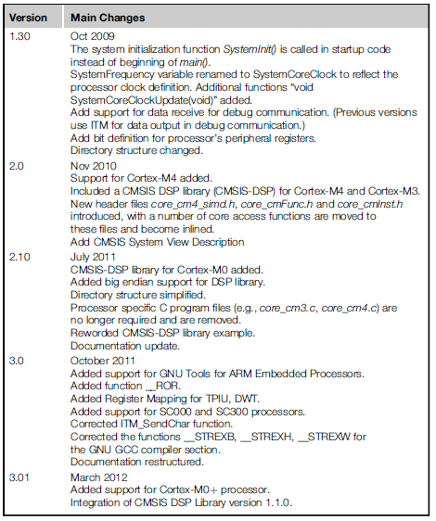
Various versions of CMSIS
https://www.arm.com/cmsis

